Slide 1
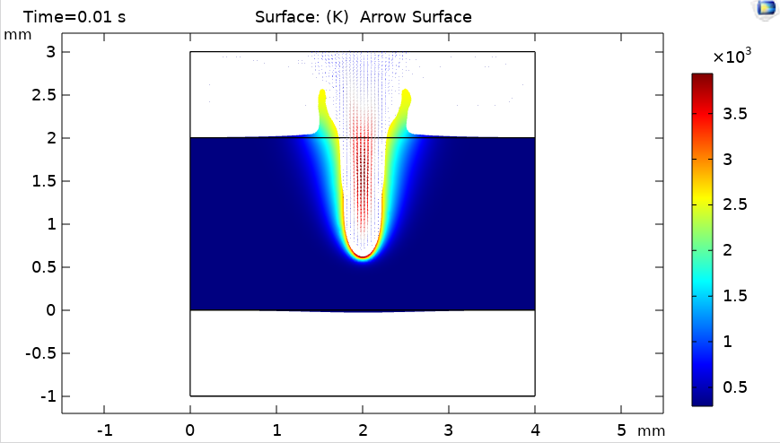
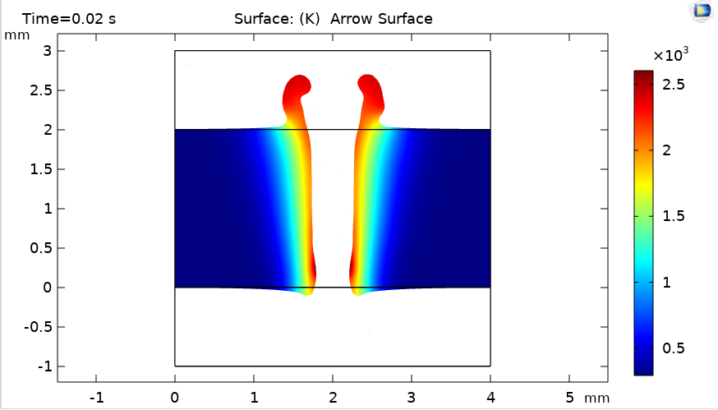
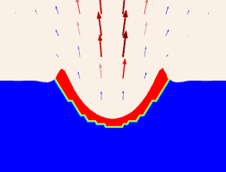
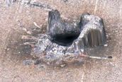
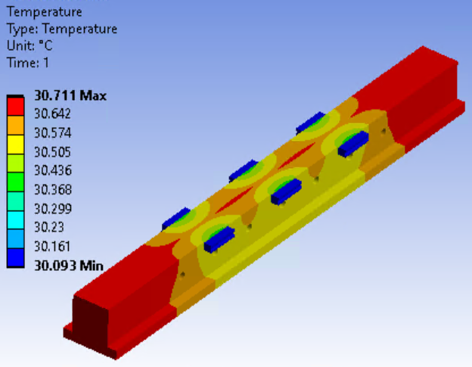
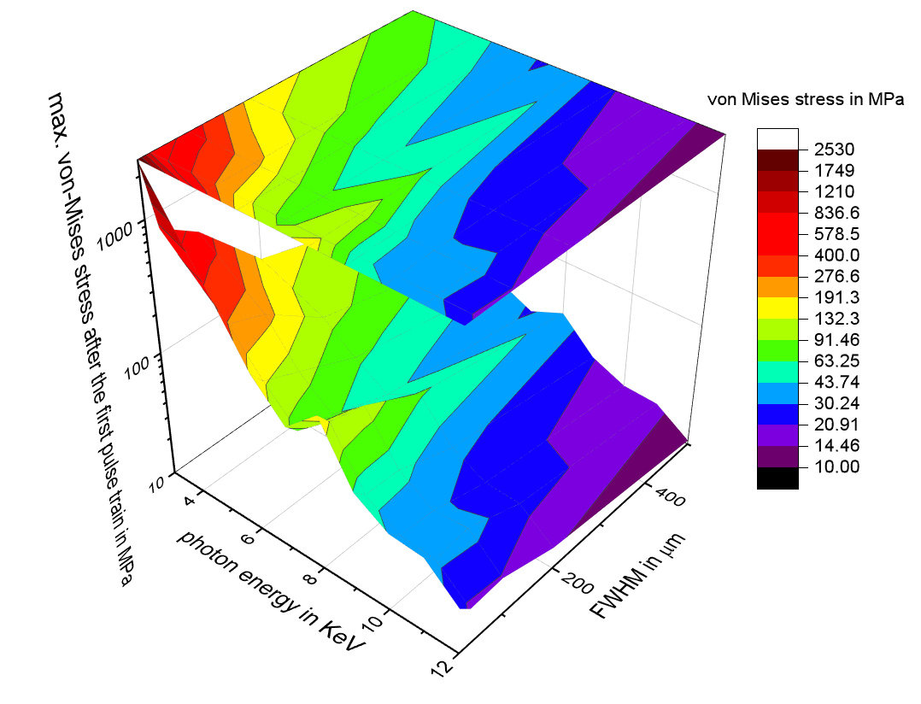
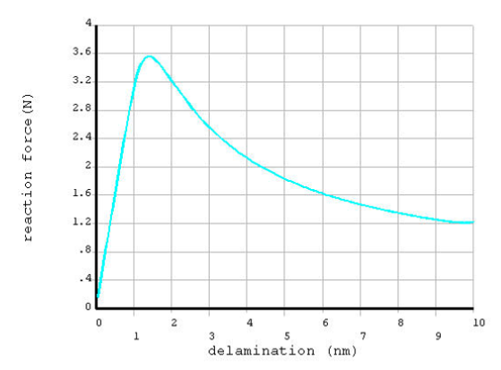
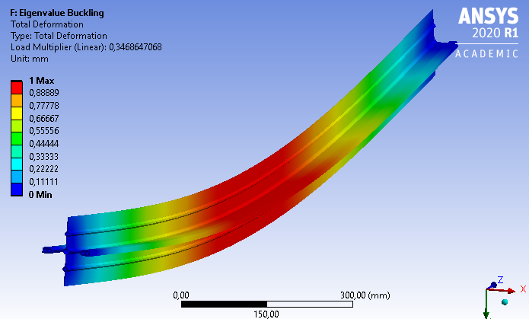
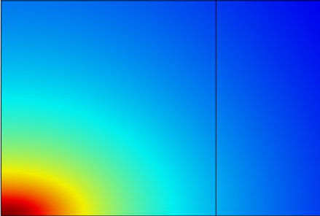
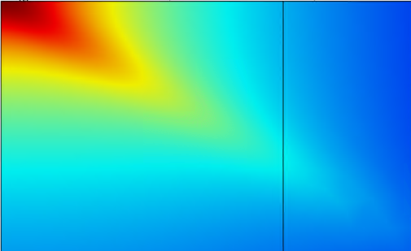
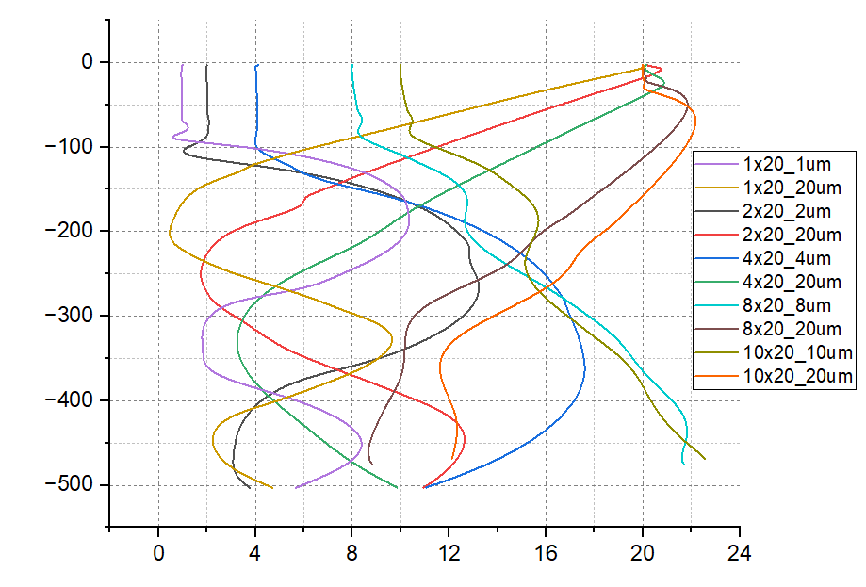
Overview of FEA/CFD simulations at EuXFEL
1st Simulation Users‘ Meeting at DESY/EuXFEL 2023
F. Yang, D. La Civita, M. Planas, M. Wünschel, S. Casalbuoni, S. Karabekyan, T. Mazza, S. Göde, D. Dias Loureiro, M. Rehwald*, L. Samoylova, M. Vannoni , H. Sinn
European XFEL
* HZDR – Helmholz Zentrum Dresden-Rossendorf
Abstract / Introduction
Numerical simulation has been applied in a wide range of engineering analysis and scientific modeling at European XFEL, e.g. thermo-mechanical simulation for the optic mirrors, damage threshold verification of radiation safety components and CFD analysis of liquid sample delivery system [1]. In this contribution, a selection of multi-scale and multi-physics models using numerical simulation tools (ANSYS and COMSOL) is presented, including applications in solid structural mechanics analysis, thermal analysis with phase transition and computational fluid dynamics simulation.
Multiphysics simulation – damage and fracture
Motivation: virtually reproduce the physical interaction of the X-Ray laser beam with matters.
Damage simulation: heat conduction, convection, non-isothermal flow of the melted material, vaporization and recoil pressure are implemented in the simulation model [4].
Navier-stokes equation
Level set method
Fracture of the coating: incl. delamination, crack of the coating due to thermal load cycles, adhesion force and thermal stress analysis
Strain energy release rate of a stressed coating
Delamination crack
Thermal stress
$$ρ\left(\frac{∂u}{∂t}+\left(u∙∇\right)u\right)=∇∙\left[−PI+μ\left(∇u+{\left(∇u\right)}^{T}\right)\right]+ρg−ρβ_{l}\left(T−T_{fusion}\right)φg+K\left(T\right)u+(γ∙nκ)δ(φ)$$
Application of Finite Element Analysis
Coupled-field analysis can integrate different physics solvers in a single simulation process, which can capture more complex interactions of multi-physics fields [2], e.g. thermal-structural, magneto-structural and thermo-electric analysis, etc.. Furthermore, system coupling extends capabilities for coupling of dissimilar mesh, multiple time scales, HPC and digital twins capabilities.
$$\frac{∂φ}{∂t}+u∙∇φ−\dot{m}δ\left(φ\right)\left(\frac{1}{ρ}\right)=γ_{ls}∇∙\left(ε_{ls}∇φ−φ\left(1−φ\right)\frac{∇φ}{\left|∇φ\right|}\right)$$
drilling through model using level set method, free surface of the phases tracked with time step control and adaptive remeshing.
(a)
(b)
$$G=Z\frac{(1−υ_{c}^{2})σ^{2}t}{E_{c}}$$
$$G= Γ_{i}(Ψ)$$
$$G= Γ_{coating}$$
$$σ_{thremal}=\frac{E_{c}(α_{c}−α_{s})}{{1−ν}_{c}}∙∆T$$
reaction force evolution during delamination of the coating
Verification, Validation, Uncertainty Quantification,
FAIR principle for simulation data management,
Digital Twin modlling,
AI-based, cloud-based simulation platform
Deeply applying VVUQ (Verification, Validation, Uncertainty Quantification) standards and adhering to FAIR (Findable, Accessible, Interoperable, and Reusable) principles is crucial in simulations to ensure accuracy and reliability.
Investigating the integration of reduced-order modeling and the deployment of digital twins in the simulation workflow is essential [5].
AI-based, cloud-based simulation platform requires substantial amount of high-quality, legally approved data to train the model.
The development of a specialized AI foundation model for simulation has the potential to revolutionize the world of simulation [6].
(c)
(d₁)
(d₂)
(a) thermo-mechanical simulaton of SQS K-B mirror with 4 σ beam footprint
(b) photon energy – beam size – von Mises stress plot of CVD diamond beamstopper
(c) buckling analysis of Apple-X undulator chamber [3]
(d₁) gaussian beam profile on the surface of B4C shutter component
(d₂) exponential beam profile in the absorption depth with incidence angle
Computational Fluid Dynamics Analysis
CFD simulation has been used in flow behavior characterization of liquid jet system, bleaching effect estimation of gas attenuator, or cooling system design of detector frontend module.
References
[1] H. Sinn et al., J. Synchrotron Rad., vol. 26, pp. 692-699, 2019.
[2] F. Yang, D. La Civita, M. Vannoni, H. Sinn, proceedings of MEDSI 2021.
[3] D. La Civita, S. Casalbuoni, S. Karabekyan, et al., proceedings of MEDSI 2021.
[4] M. Dal and R. Fabbro, Optics & Laser Technology, no. 78, pp. 2-14, 2016.
[5] D. W. Wright, et al., Advanced Theory and Simulations, vol 3, Issue 8, 2020.
[6] LEAM: AI, the feasibility study, https://leam.ai/, 2023.
Simulation enables the conduct of parametric studies to investigate the impact of various parameters on flow behaviour, such as viscosity, surface tension, flow velocity, pressure, etc.. The provided plot illustrates the effects of different nozzle geometries on the sheet jet flow.
Acknowledgements
We acknowledge the collaborations with DESY D3 and ZM1 groups, as well as SPB, HED, MID, SQS, FXE, SEC, DET, SRP, XRO, XPD, and UNSYS groups at EuXFEL.
flow evolution of liquid hydrogen sheet jet
European XFEL GmbH, Holzkoppel 4, 22869 Schenefeld, Germany, fan.yang@xfel.eu
www.xfel.eu

